Slide 1
Online learning platform

Slide 2
introduction
Online learning platforms have transformed the educational landscape, offering a flexible and accessible approach to acquiring knowledge and skills.
In the digital era, learners are no longer confined to traditional classrooms but can engage in education from the comfort of their homes.

Slide 3
Why online learning platform?
Flexibility: Learn at your own pace, anytime, and anywhere.
Diverse Courses: Access a wide range of subjects and skill levels.
Interactive Content: Engaging multimedia, quizzes, and collaborative tools.
Global Reach: Connect with learners from around the world.

Slide 4
Advantages of learners
Study around your schedule.
Save on commuting and accommodation.
Acquire new skills for personal and professional growth.
Progress at your own speed.

Slide 5
Technologies used
HTML
CSS

Slide 6

HTML
HTML, or Hyper Text Markup Language, is the standard markup language used to create and structure content on the World Wide Web. It serves as the backbone of web pages, defining the elements and their arrangement to ensure proper display in web browsers.

Slide 7

css
CSS, or Cascading Style Sheets, is a style sheet language used to describe the presentation and formatting of a document written in HTML or XML. In web development, HTML defines the structure of a web page, and CSS is responsible for styling and layout, separating the content from its visual representation.
This Photo by Unknown Author is licensed under CC BY-SA

Slide 8
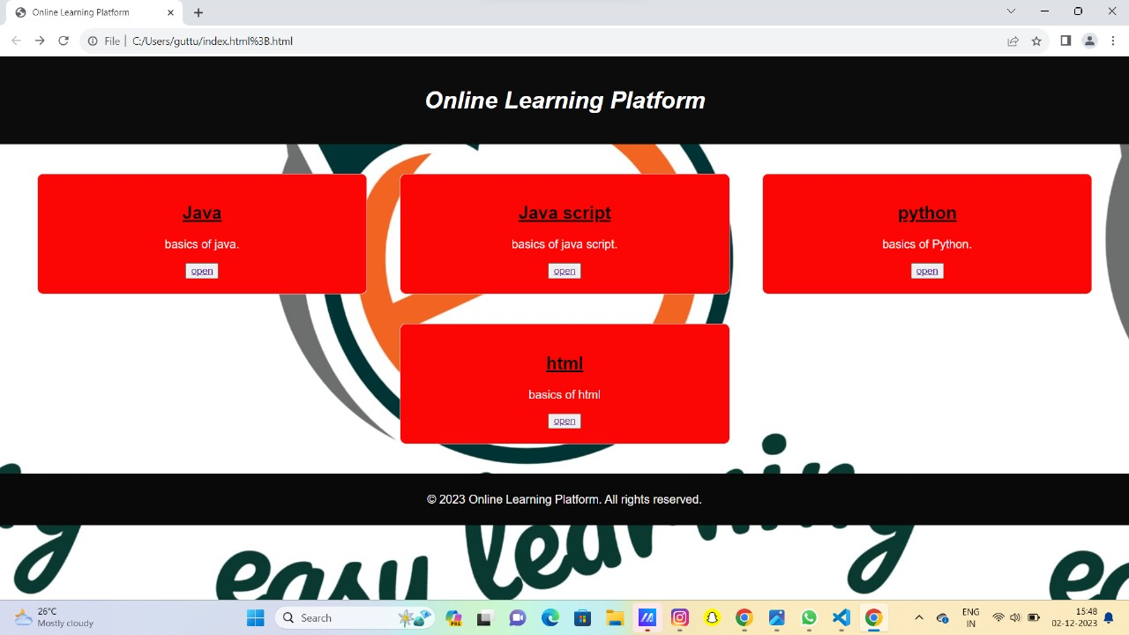
output

Slide 9
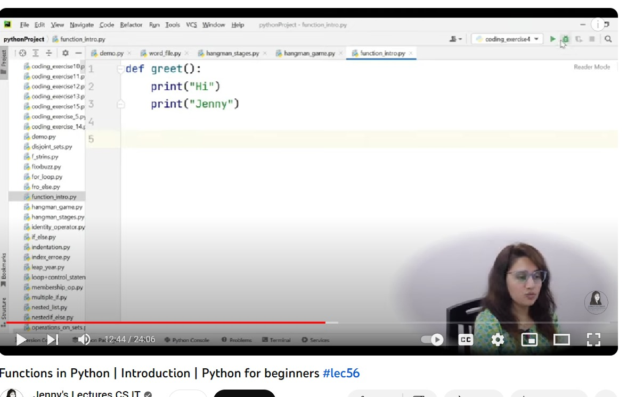
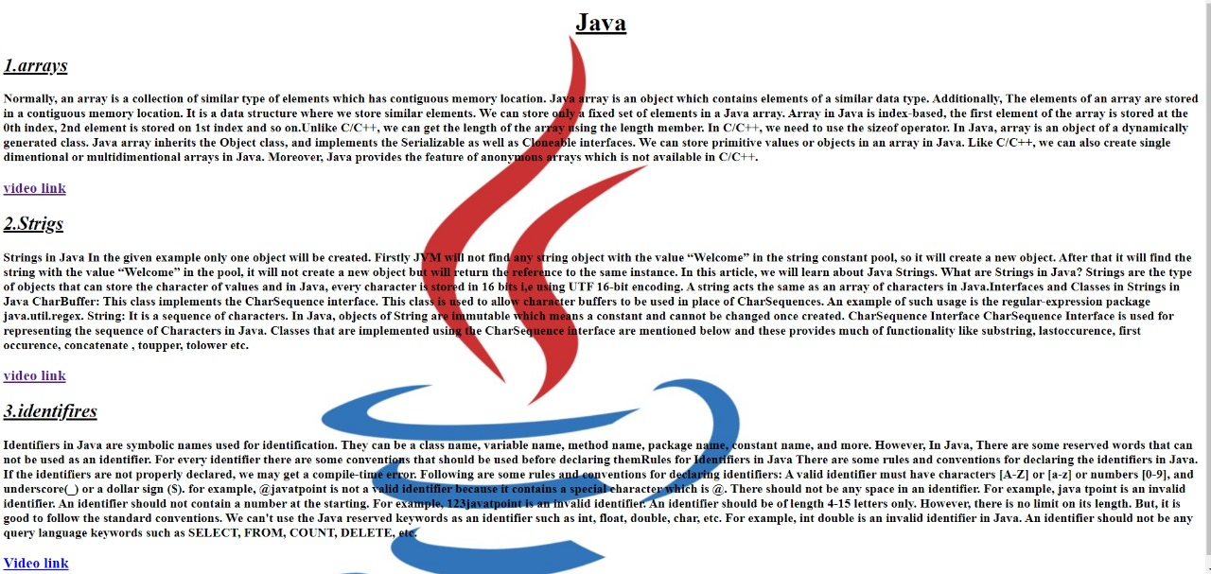
Output for redirect link

Slide 10
Thank you
By team 5
Aid dayscholars
1.Lakshman kumar 2.Dhanesh
3.Satya manikanta reddy 4.Chaitanya
5.Sanddep 6mohan
7.venkatesh

